Slide 1
Angular training
Angular form and Reactive Form

Slide 2
Introduction to Angular Form
ANGULAR - INTRODUCTION TO ANGULAR ROUTER
Web applications use forms when it comes to collecting data from the user. Use cases vary from allowing users to log in, filling in payment information, booking a flight, or even performing a search.
Form data can later be persisted on local storage or be sent to a server using a backend API.
A form usually has the following characteristics that enhance the user experience of a web application:
Can define different kinds of input fields
Can set up different kinds of validations and display validation errors to the user
Can support different strategies for handling data if the form is in an error state

Slide 3
Introduction to Angular Form
The Angular framework provides two approaches to handling forms: template-driven and reactive. The main difference between the two approaches is how they manage data:
• Template-driven forms are easy to set up and add to an Angular application, but they do not scale well. They operate solely on the component template to create elements and configure validation rules; thus, they are not easy to test. They also depend on the change detection mechanism of the framework.
• Reactive forms are more robust when it comes to scaling and testing and when they are not interacting with the change detection cycle. They operate in the component class to manage input controls and set up validation rules. They also manipulate data using an intermediate form model, maintaining their immutable nature. This technique is for youif you use reactive programming techniques extensively or if your Angular application comprises many forms.

Slide 4
Data binding with template-driven forms
Template driven forms use a two-way binding that can read and write data simultaneously.
Template-driven forms provide the ngModel directive, which we can use in our components to get this behavior.

Slide 5
Two way data binding explanation
name: string = “”
ENter your name
{{ name }}
In two way data binding, when user enter information in the input, the variable name will be updated automatically.
Since there is a change on the variable, the value in {{ }} will be updated in real time as well

Slide 6
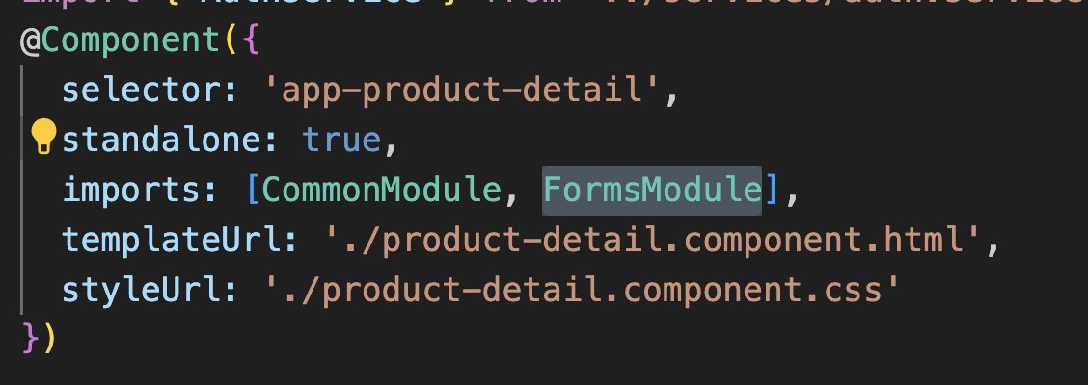
Data binding with template-driven forms (2)
product-detail.component.ts

Slide 7
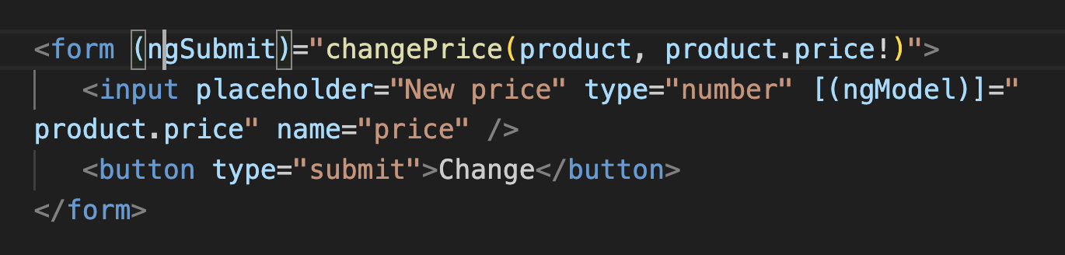
Data binding with template-driven forms (3)
product-detail.component.ts
Verify the two way data binding behaviour.
While we type inside the input box, the ngModel directive updates the value of the product price. The new price is directly reflected in the template because we use Angular interpolation syntax to display its value

Slide 8
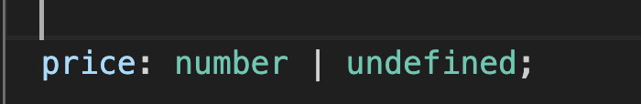
Data binding with template-driven forms (3)
product-detail.component.ts

Slide 9
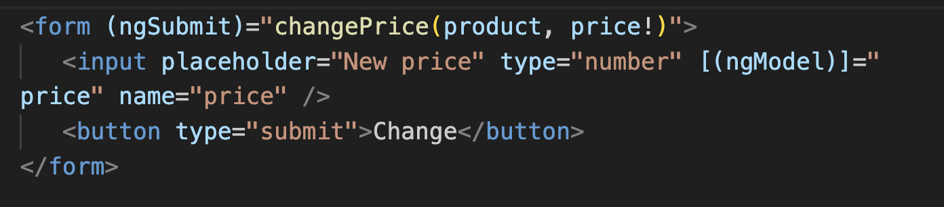
Data binding with template-driven forms (4)
product-detail.component.html

Slide 10
Reactive Forms
Reactive forms, as the name implies, provide access to web forms in a reactive manner. They are built with reactivity in mind, where input controls and their values can be manipulated using observable streams.
They also maintain an immutable state of form data, making them easier to test because we can be sure that the state of the form can be modified explicitly and consistently
Reactive forms have a programmatic approach to creating form elements and setting up validation rules. We set everything up in the component class and merely point out our created artifacts in the template.

Slide 11
Reactive Forms (2)
The Angular key classes involved in this approach are the following:
FormControl: Represents an individual form control, such as an <input> element.
FormGroup: Represents a collection of form controls. The <form> element is the top most FormGroup in the hierarchy of a reactive form.
FormArray: Represents a collection of form controls, just like FormGroup, but can be modified at runtime. For example, we can add or remove FormControl objects dynamically as needed.

Slide 12
Example of Dyanmic Form
Product A
1
Product B
2
Product C
1

Slide 13
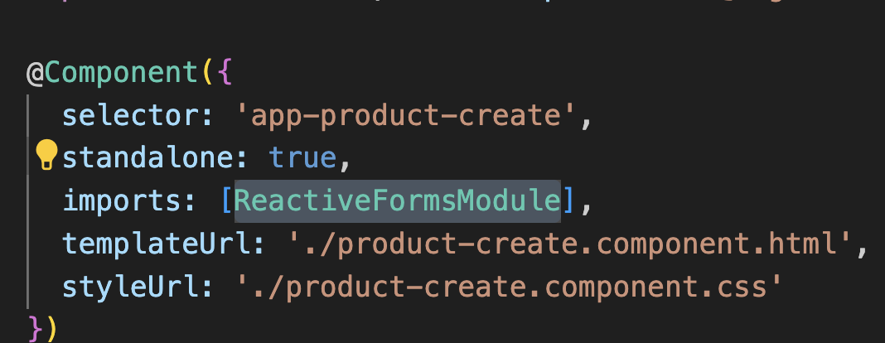
Reactive Forms (3)
product-create.component.ts

Slide 14
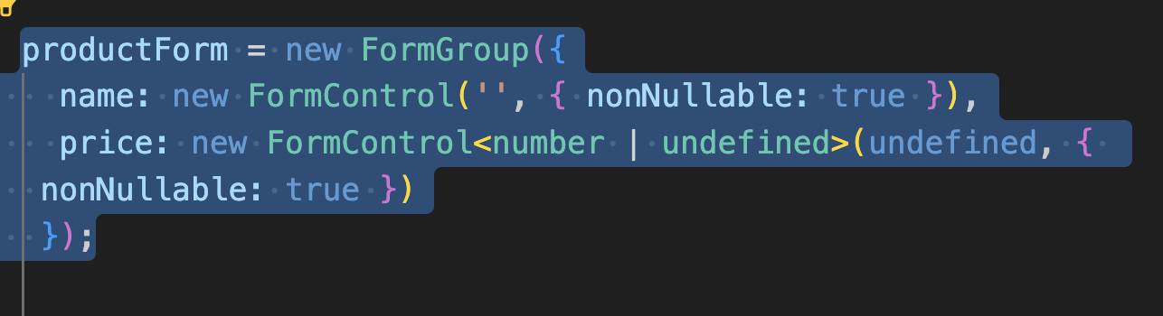
Reactive Forms (3)
product-create.component.ts

Slide 15
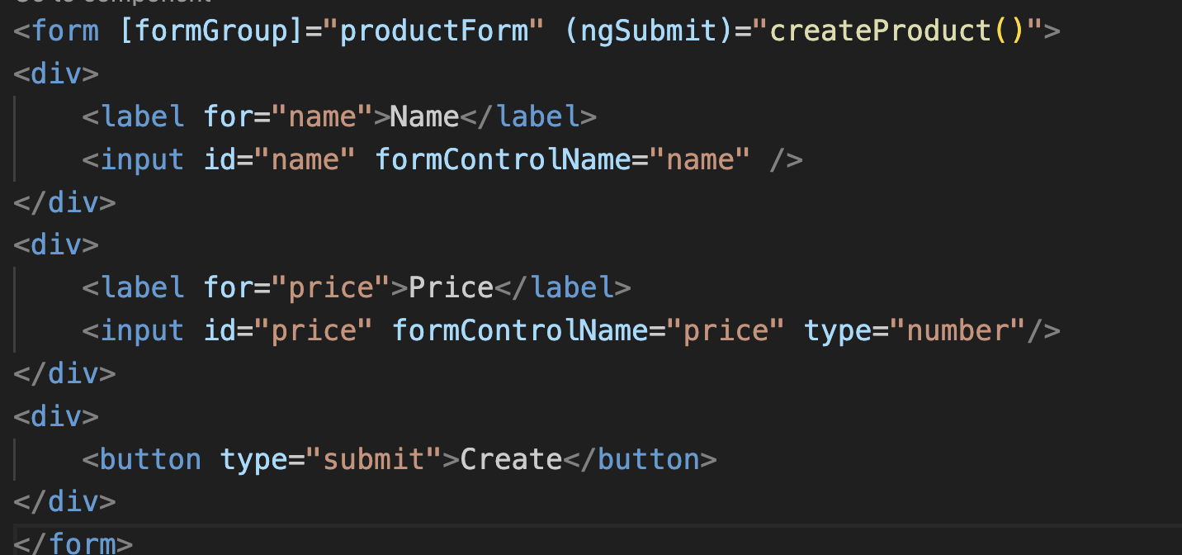
Reactive Forms (4)
product-create.component.html

Slide 16
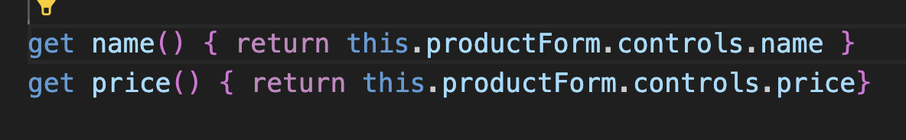
Reactive Forms (5)
product-create.component.ts

Slide 17
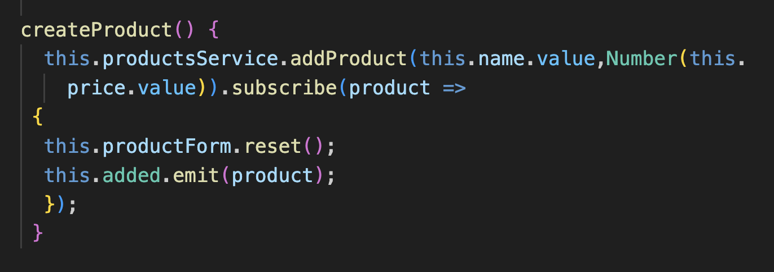
Reactive Forms (6)
product-create.component.ts

Slide 18
Providing form status feedback
The Angular framework sets the following CSS classes automatically in a form control according to the current status of the control:
ng-untouched: Indicates that we have not interacted with the control yet
ng-touched: Indicates that we have interacted with the control
ng-dirty: Indicates that we have set a value to the control
ng-pristine: Indicates that the control does not have a value yet
ng-valid: Indicates that the value of the control is valid
ng-invalid: Indicates that the value of the control is not valid
Each class name has a similar property in the form model. The property name is the same as the class name without the ng- prefix. We could try to leverage both and provide a unique experience with our forms.

Slide 19
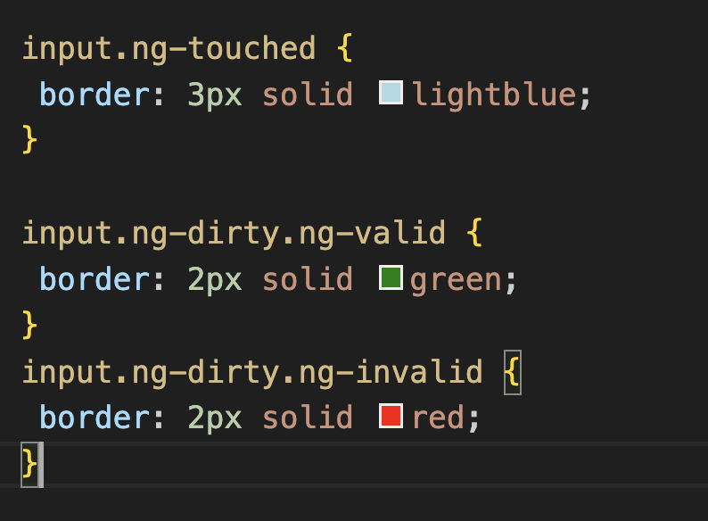
Providing form status feedback (2)
styles.css

Slide 20
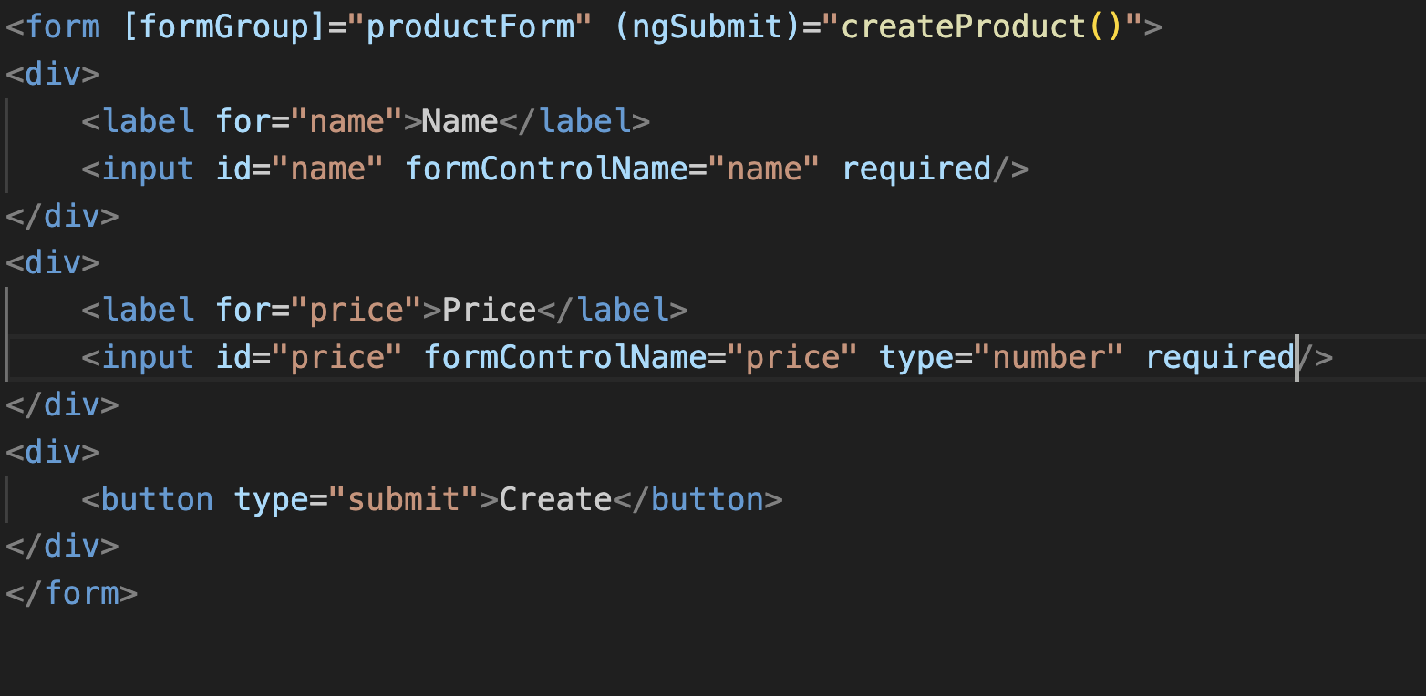
Providing form status feedback (3)
Add validation rules (required) to verify the style.

Slide 21
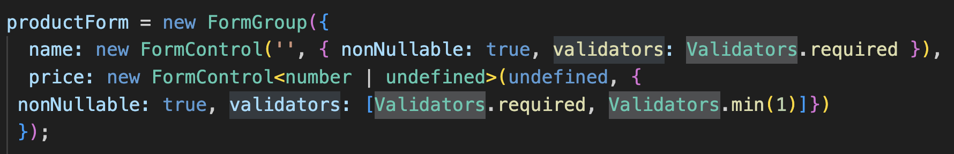
Validating controls in a reactive way
We will look how we are able to define validation rules when building the FormGroup instance and perform validation at the form control level.
create-product.component.ts
https://angular.io/guide/form-validation
https://angular.io/api/forms/Validators

Slide 22
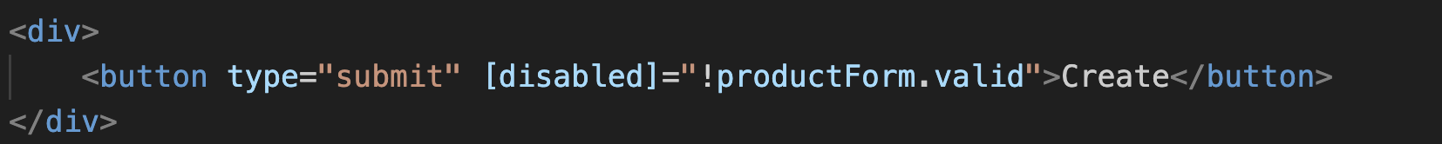
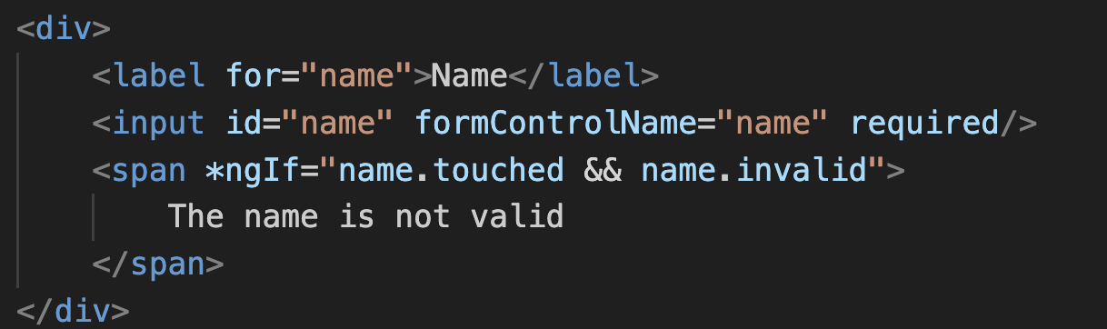
Validating controls in a reactive way (2)
Using valid property, you can check if the form is valid or not.
You may also verify the state of the form control, eg: input, and comes out with message, for eg create-product.component.ts

Slide 23
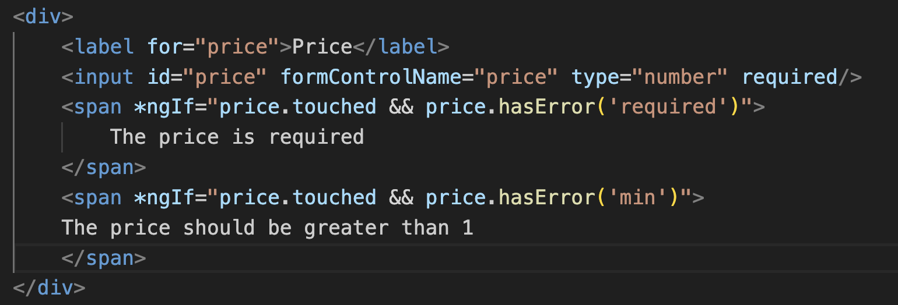
Validating controls in a reactive way (3)
create-product.component.ts

Slide 24
Validating controls in a reactive way (4)
The Angular framework provides a set of built-in validators that we can use in our forms.
A validator is a function that returns either a ValidationErrors object or null when the control does not have any errors.
According to the scenario, a validator can also return a value synchronously or asynchronously
https://angular.dev/api/forms/Validators

Slide 25
Building a custom validator
With that principle we can write a custom validator and use it in an Angular reactive form.
In this example, we will build a validator to check whether the price of a product is in a predefined amount range.
ng g directive price-range

Slide 26
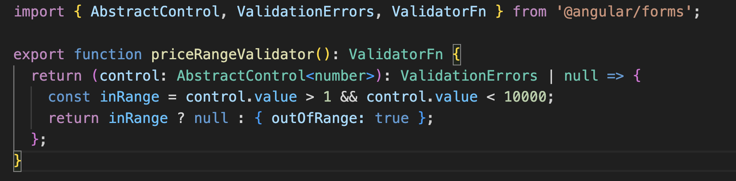
Building a custom validator (2)
https://angular.io/api/forms/ValidatorFn
https://angular.io/api/forms/ValidatorFn

Slide 27
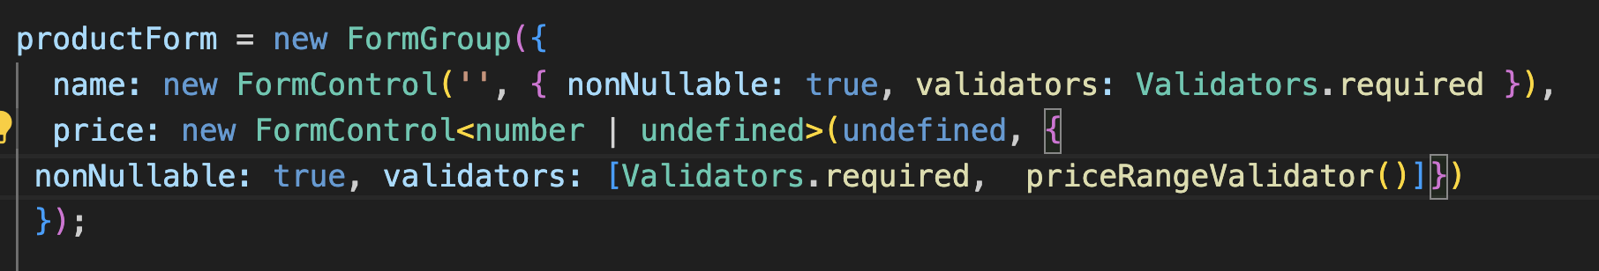
Building a custom validator (3)
product-create.component.ts

Slide 28
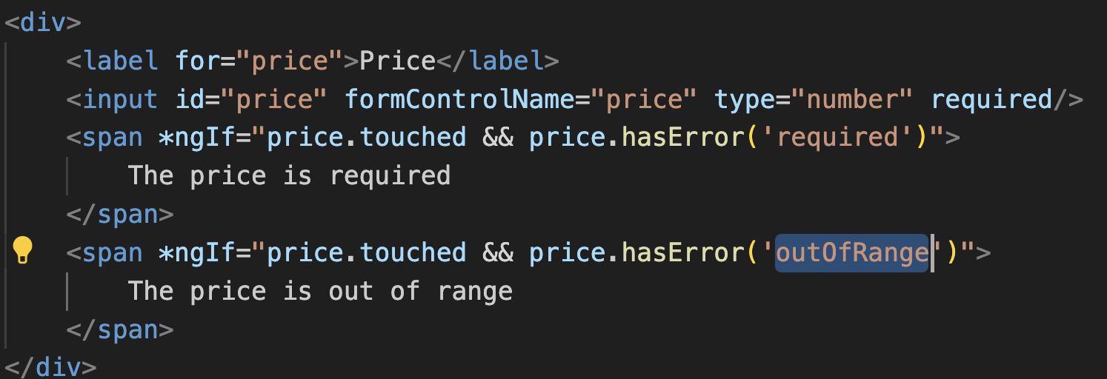
Building a custom validator (4)

Slide 29
Watching state change on a form
A reactive form can listen to changes in the form controls when they happen and react accordingly. A suitable reaction could be to disable/enable a control, provide a visual hint, or do something else according to your needs.
A FormControl instance contains two observable properties: statusChanges and valueChanges.
statusChanges: notifies us when the status of the control changes, such as going from invalid to valid.
valueChanges: notifies us when the value of the control changes.

Slide 30
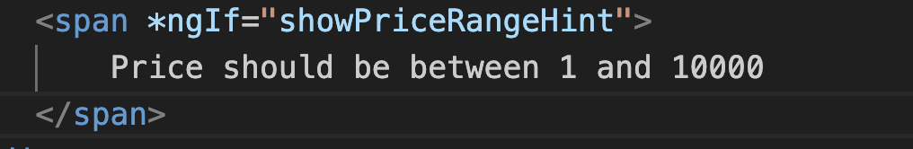

Watching state change on a form (2)
Create-product.component.html
create-product.component.ts

Slide 31
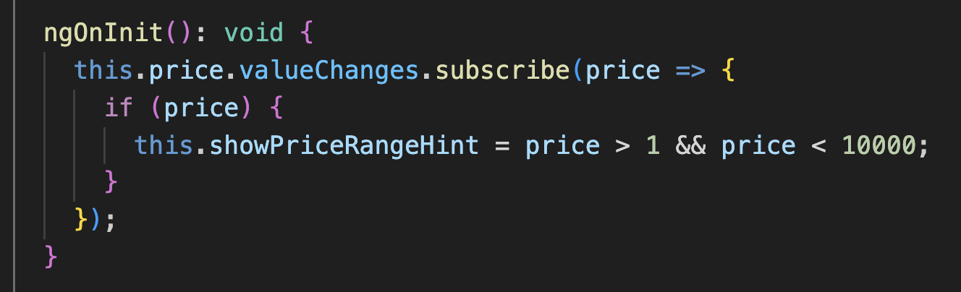
Watching state change on a form (3)
create-product.component.ts
Subscribe to valueChanges on the ngOnInit

Slide 32
Modifying a dynamic form
Angular’s FormArray is a powerful tool for managing dynamic forms in your Angular applications. It allows you to handle scenarios where the number of form controls is not fixed and can change dynamically during runtime.
In this example we will create a cart page that will show an item dynamically based on the number of items user added in cart

Slide 33
Modifying a dynamic form (2)
Create a cart service
ng generate service cart

Slide 34
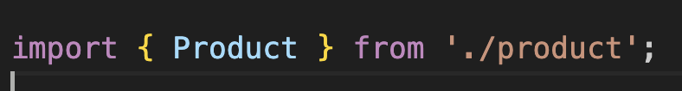
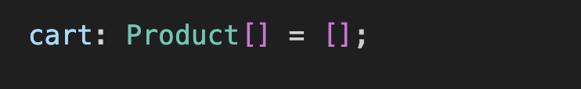
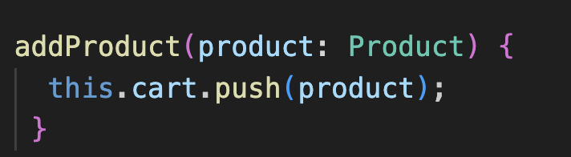
Modifying a dynamic form (3)
cart.service.ts

Slide 35
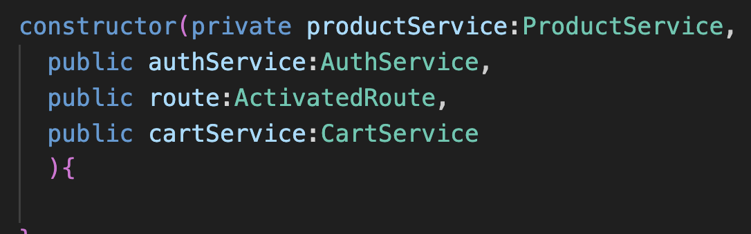
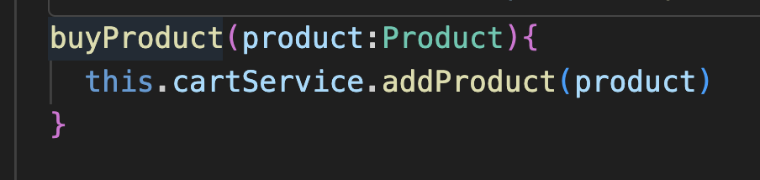
Modifying a dynamic form (4)
product-detail.component.ts

Slide 36
Modifying a dynamic form (5)
product-detail.component.html

Slide 37
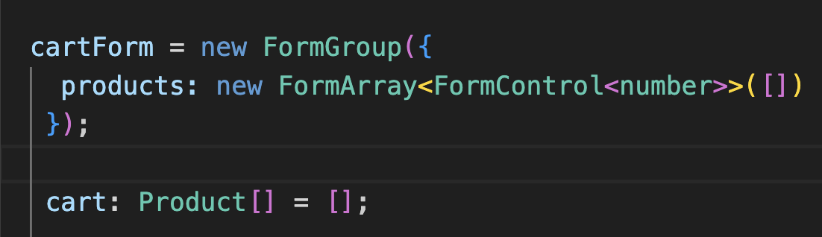
Modifying a dynamic form (6)
cart.component.ts

Slide 38
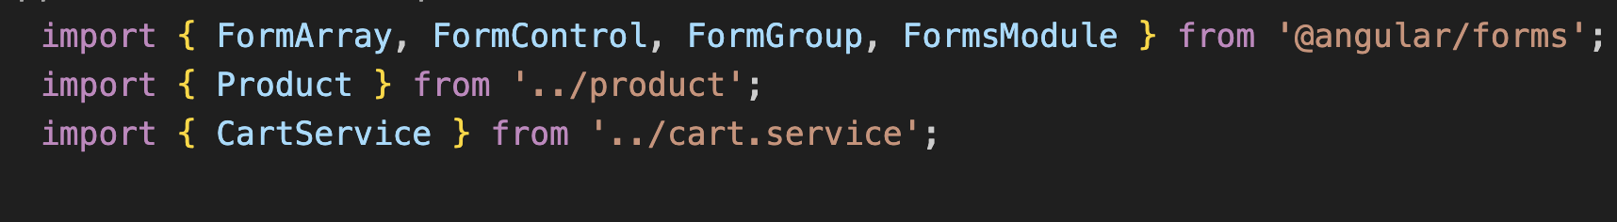
Modifying a dynamic form (7)
cart.component.ts

Slide 39
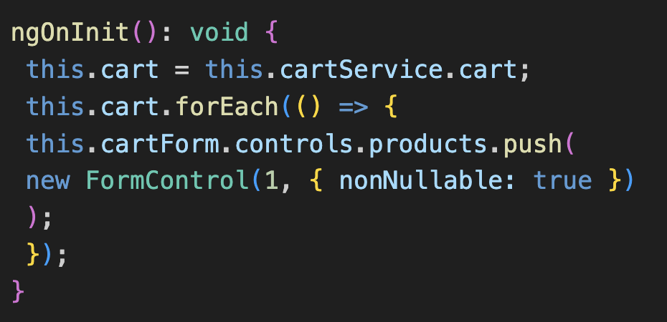
Modifying a dynamic form (8)
cart.component.ts

Slide 40
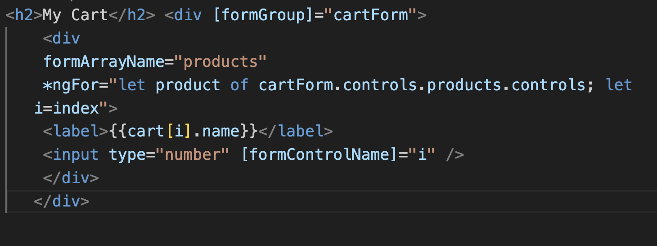
Modifying a dynamic form (9)
cart.html.ts

Slide 41
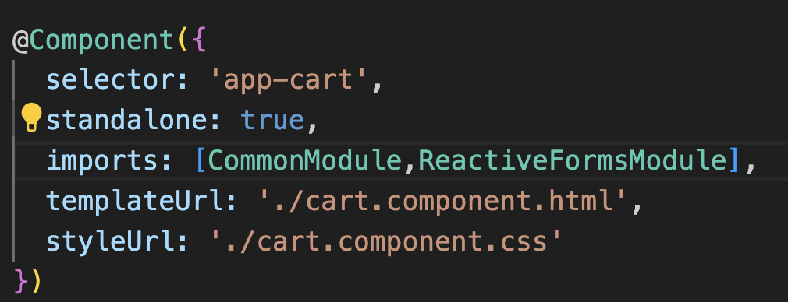
Modifying a dynamic form (10)
cart.component.ts

Slide 42
Example retrieve value
itemSubmit() {
const data: any = this.cartForm.controls.products.controls.map((val, index) => ({ 'item': this.cart[index], 'quantity': val.value }))
console.log(data);
}

